Slide 1
ENME691 HW3
Brian O’Malley
Ashwin Sudarshan
Sai Dinesh Gelam

Slide 2
Table of contents
Introduction
Methodology
Results & Discussion
Conclusion

Slide 3
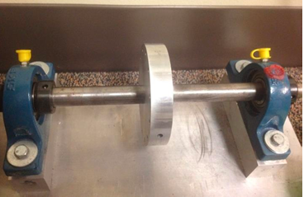
Introduction
A rotor-bearing testbed was built to analyze the health condition of the shaft with unbalance defects.

Slide 4
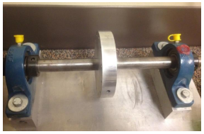
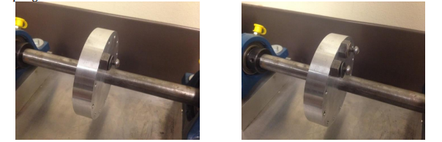
Problem Description
Rotating speed of test-bed: 20 Hz
Screws added on the disk of the shaft to induce unbalanced defects
Accelerometer mounted on the bearing block to measure vibrations
Vibration data collected under normal condition and unbalanced condition
Sampling rate: 2560 Hz
Balanced test bed
Unbalanced test bed with 1 (left) and 2 (right) screws

Slide 5
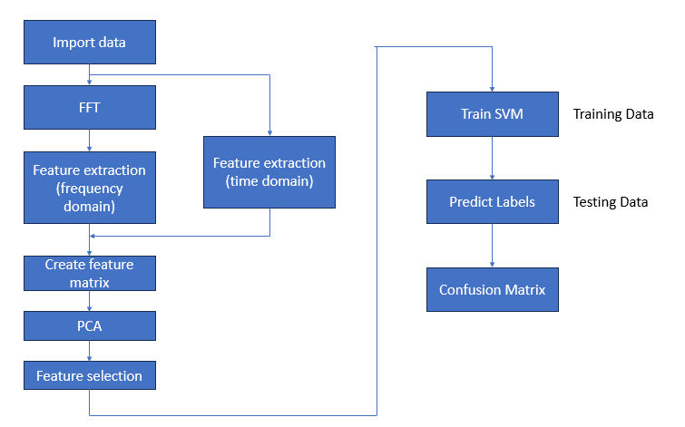
Workflow

Slide 6
Data Analysis
Data Loading
Load vibration data from three datasets: healthy, faulty, and testing.
Pre-processing
Apply filtering to remove noise and unwanted frequencies.
Normalize the data to ensure uniformity across all samples.
Feature Extraction
Utilize frequency domain analysis to identify key features that distinguish healthy conditions from faulty ones.
Focus on extracting features such as the amplitude of the 1X harmonic component, which is directly related to the shaft's rotating speed.

Slide 7
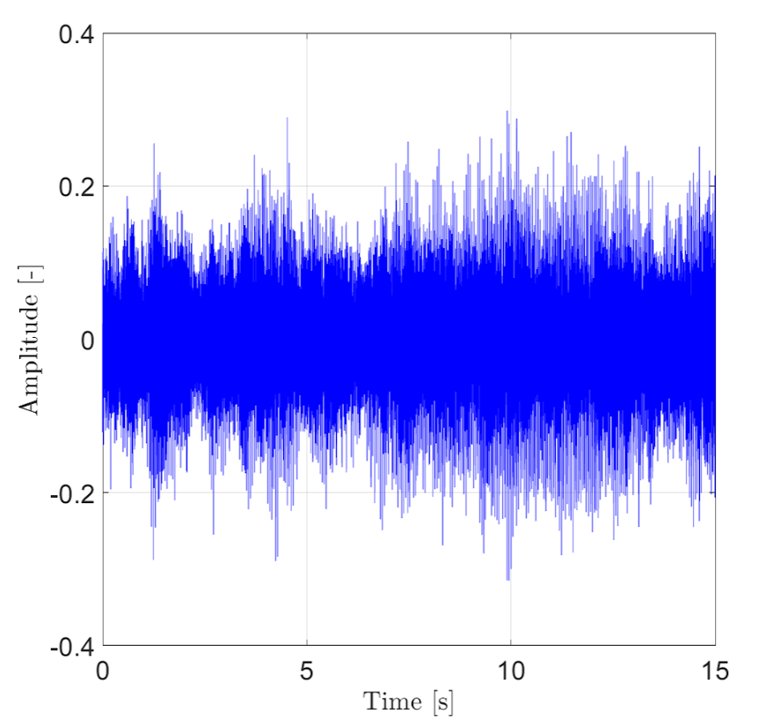
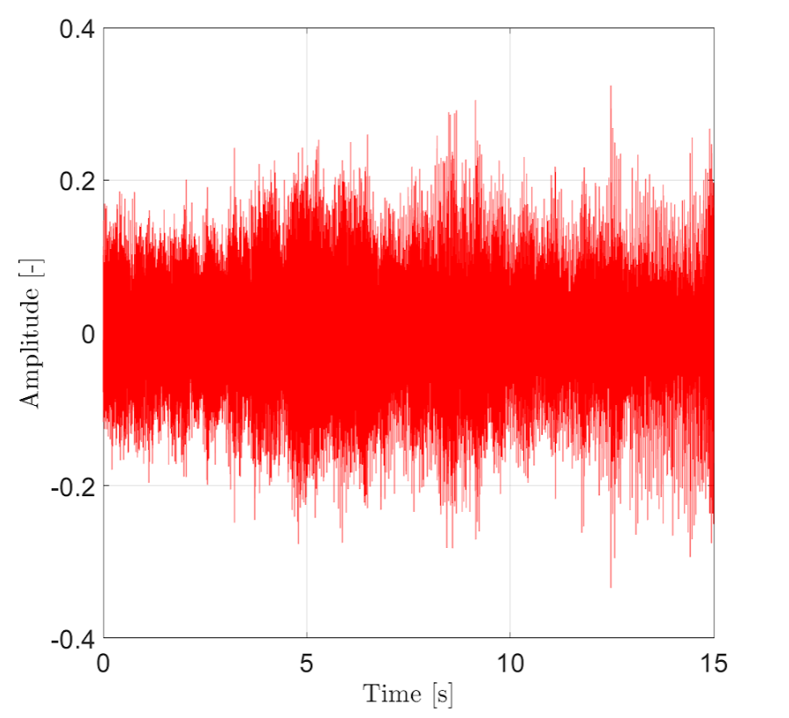
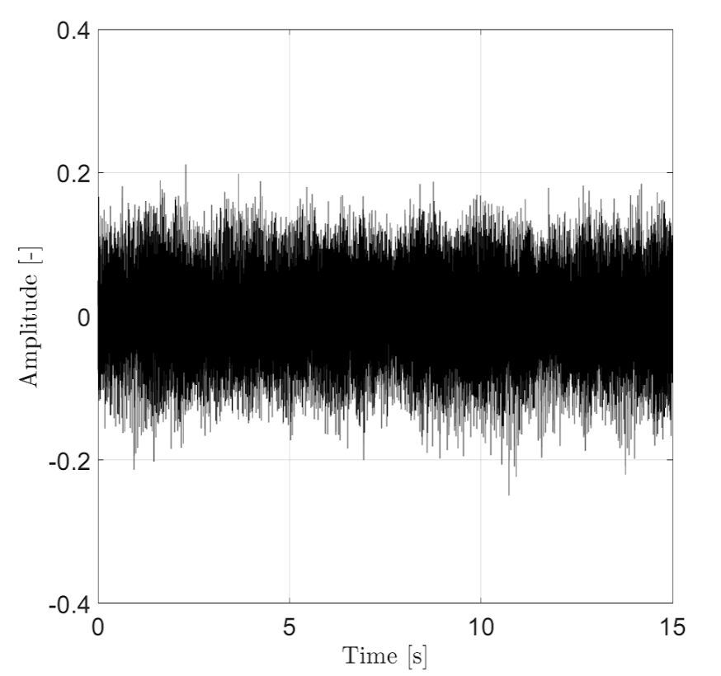
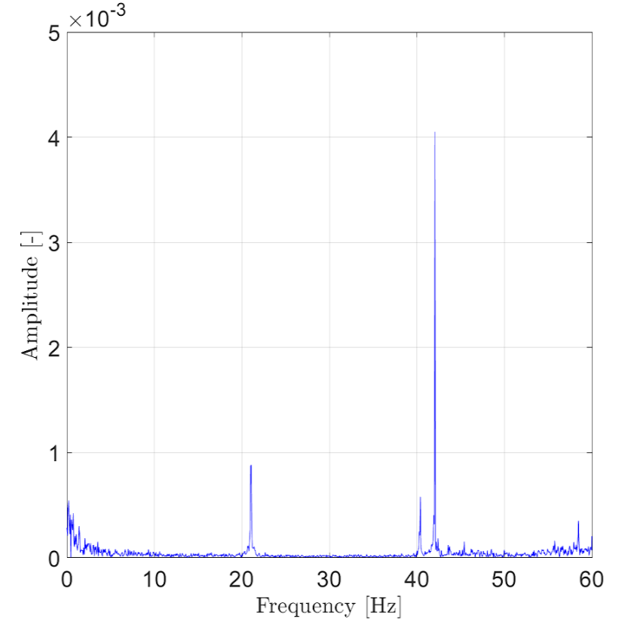
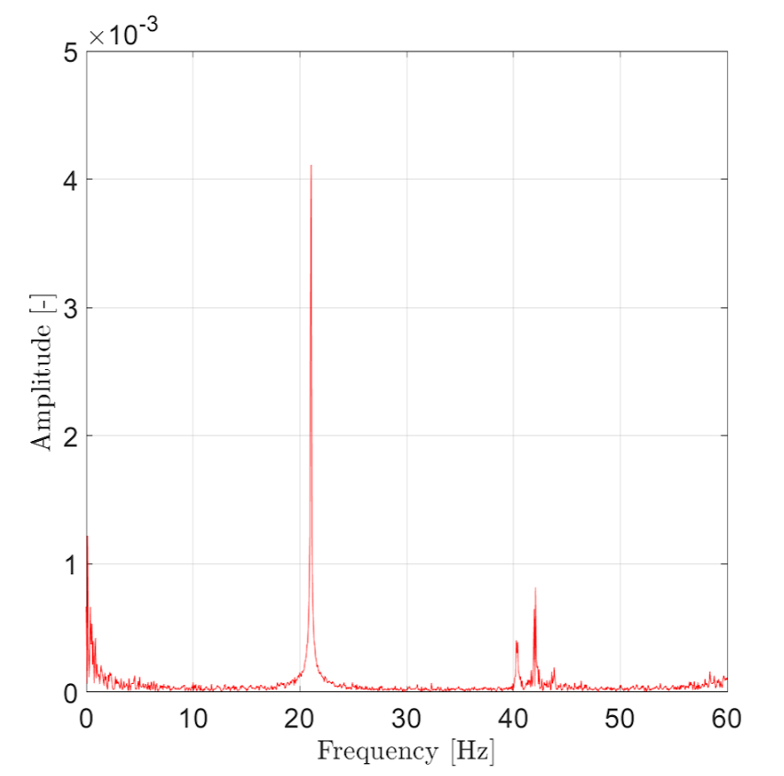
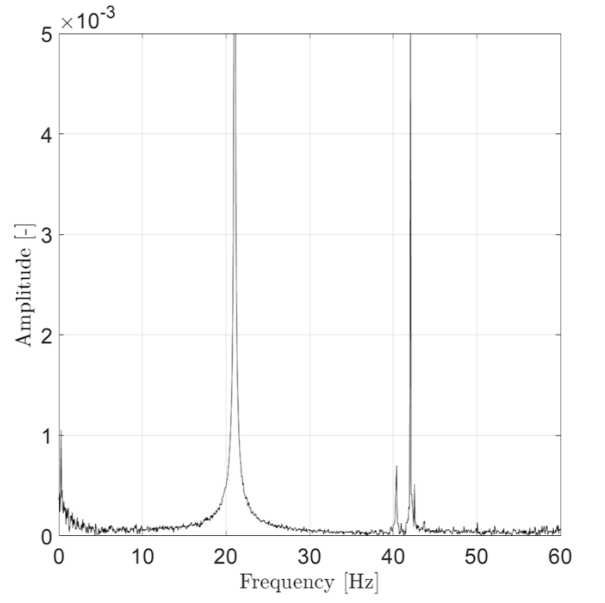
Data Analysis Cont’d
Time domain
Frequency domain
Healthy
Faulty unbalance 1
Faulty unbalance 2

Slide 8
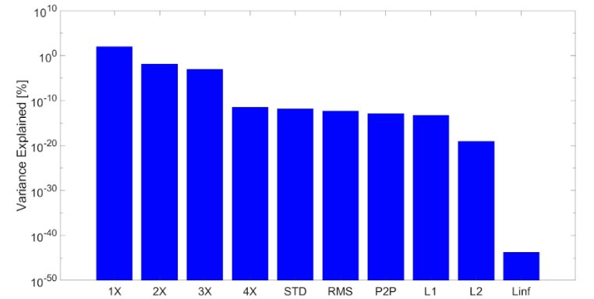
Principal Component Analysis
1X and 2X harmonic frequencies appear are the dominant features

Slide 9
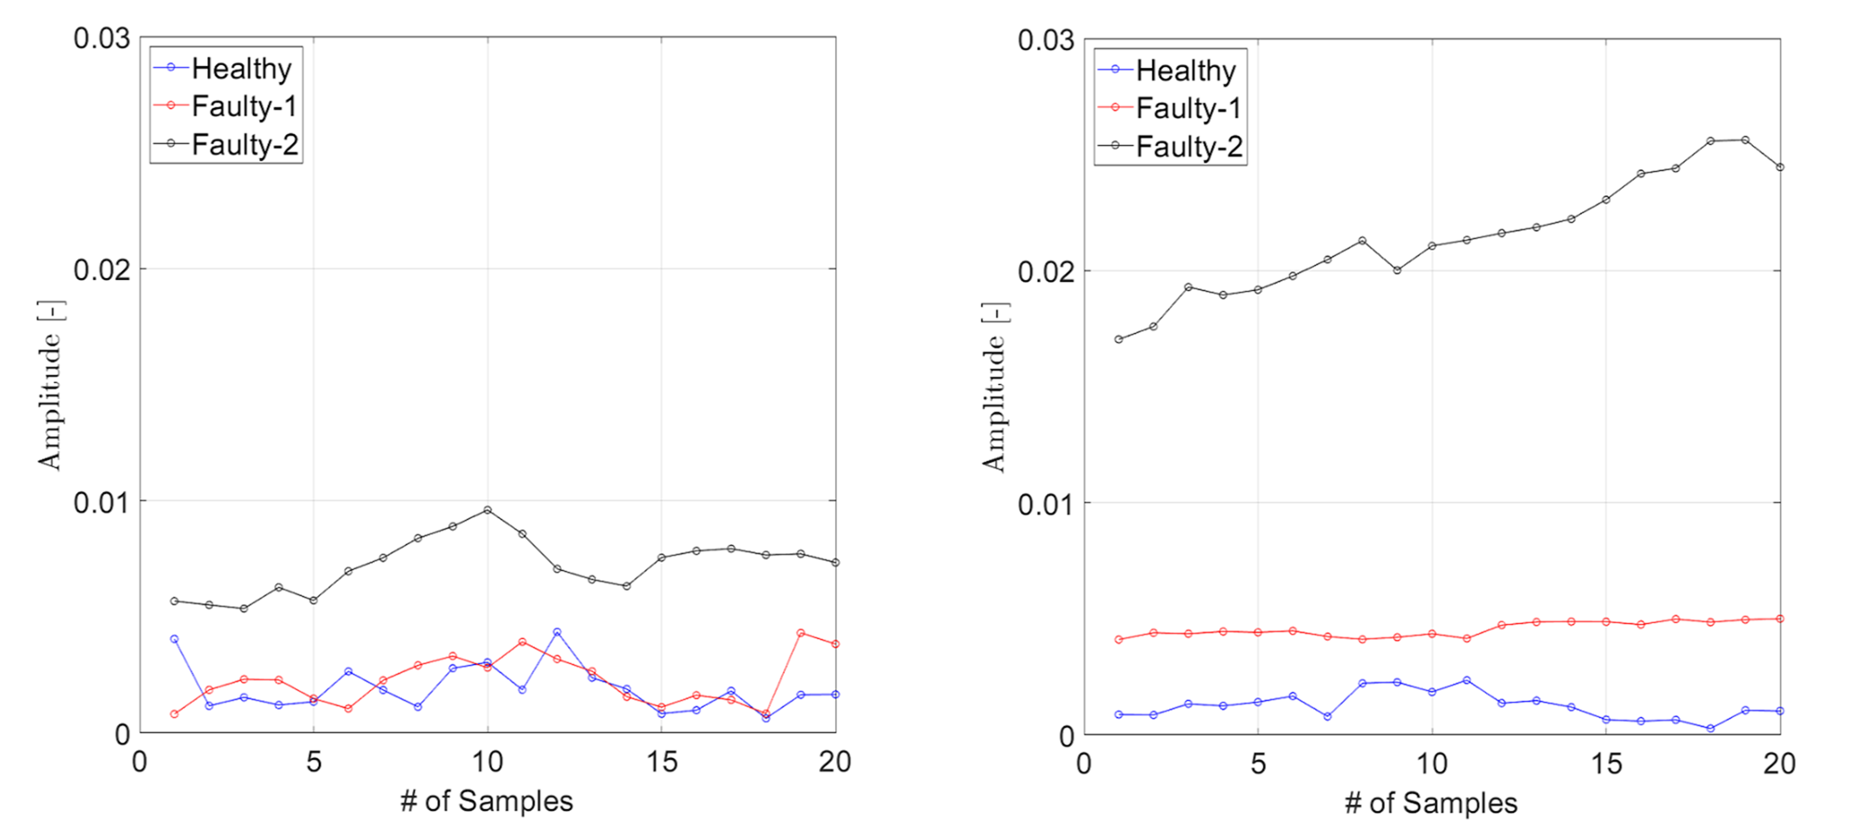
Feature Extraction
Amplitude at 1X (left) and 2X (right) harmonic frequency

Slide 10
Methodology: Model Training
Model Training
Train a SVM model using the extracted features (at 1X and 2X harmonics, this is decided by conducting PCA for various features) from the healthy, faulty_1 & faulty_2 datasets.
The model learns the patterns associated with each condition, enabling it to differentiate between healthy and faulty states.
Model Testing and Classification
Test the trained model on the unlabeled dataset.
Classify each signal in the testing dataset as either healthy or faulty_1 or faulty_2 based on the learned patterns using confusion matrix.
Conclusion
The process leverages signal processing and machine learning to effectively assess the health condition and level of faulty behaviour by training with appropriate data sets.

Slide 11
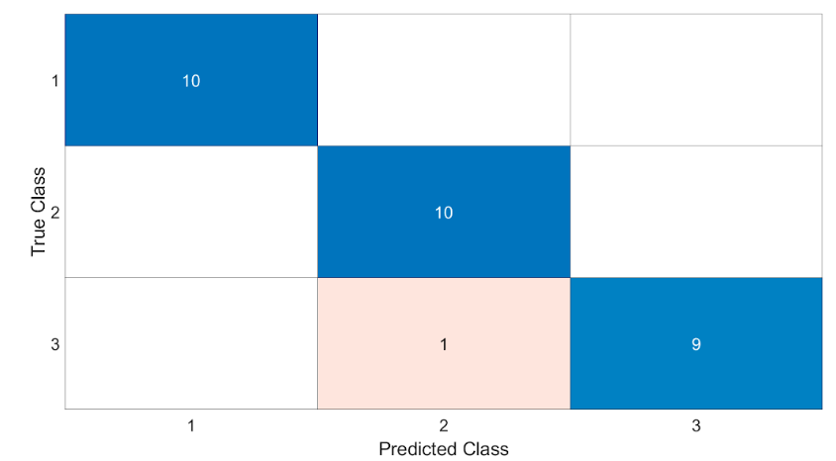
Confusion Matrix
Healthy → 1
Faulty 1 → 2
Faulty 2 → 3

Slide 12
Conclusion
Effective Diagnosis with Logistic Regression:
The implementation of SVM effectively classifies vibration signals into healthy, unbalanced_1 and unbalanced_2 cases.
The minimal misclassification (1/30 cases) between Faulty Level 1 and Level 2 indicates the model's sensitivity to changes in harmonic amplitudes, underscoring the effectiveness of our feature selection.
Future Direction
Explore more complex machine learning algorithms.
Include additional features to enhance model accuracy.

